Slide 1

WannaHang @ SIT Project Presentation

Slide 2
Table of contents
01
02
03
04
05
06
Login
User Interface
Settings Page
Game Logic (Hint)
Game Logic (Health/Regen)
Game Logic (Difficulty/Timer)

Slide 3
Table of contents
07
08
09
10
Game Logic (Validation)
Game Logic (Images)
Music
Game Logic (Completion)

Slide 4

01
Login

Slide 5
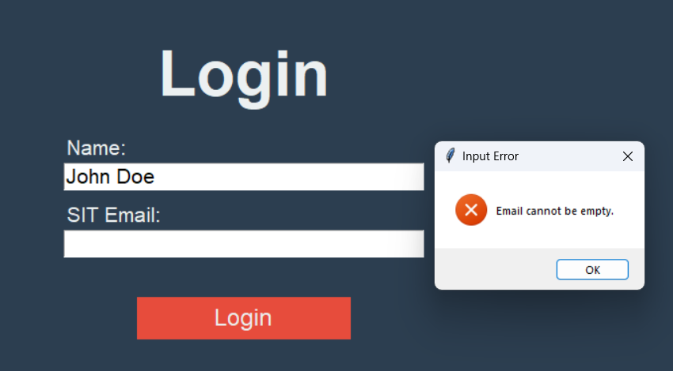
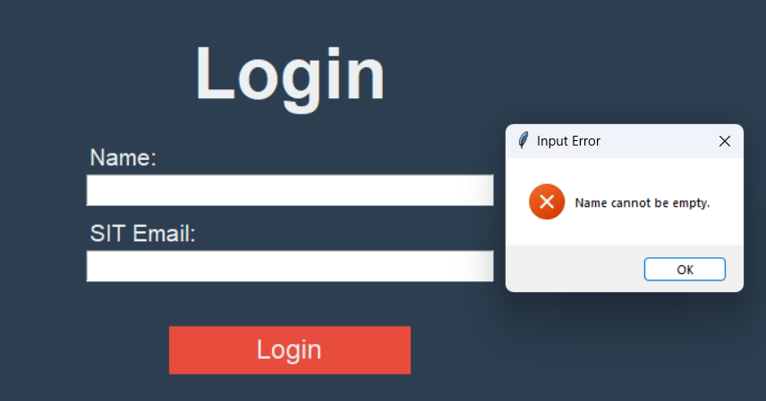
Login Validation
If the user leaves either the name or email fields empty, an error will be shown, showing what they have done wrongly
Notes:
Starting with the login system, we focused on user validation to ensure that users provide correct information. Specifically, the username and email fields cannot be left empty. If either of these fields is left blank, the user is prompted with an error message.

Slide 6
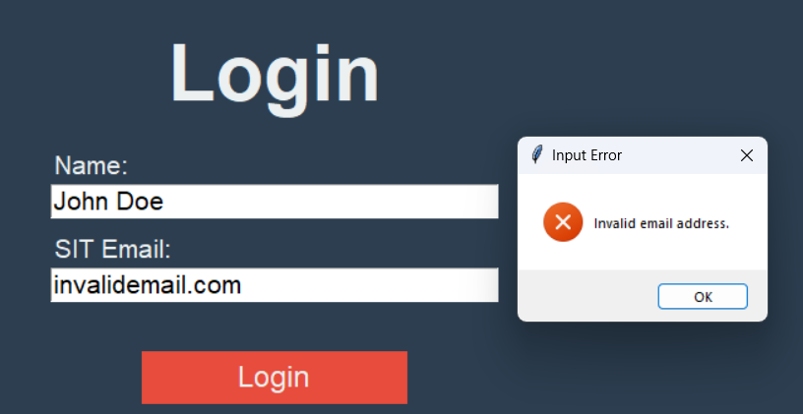
Login Validation
If the email is not valid, error will be shown
Notes:
We also implemented email validation. If the email format is invalid, for example, if it's missing an '@' symbol , the user will receive an error message indicating that the email is not acceptable. Here's a screenshot showing how the validation works, where you can see how the form reacts to invalid input.

Slide 7
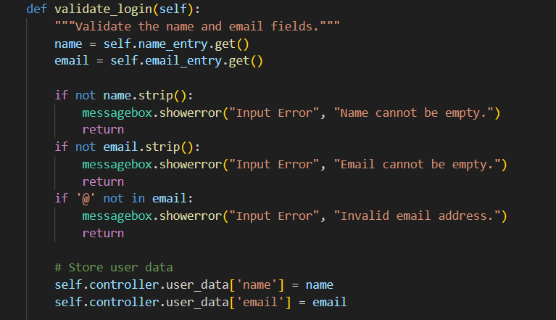
Login Code
Notes:
Once the user has entered valid information, their data is stored locally. While this is sufficient for a small project like ours, in larger projects, this data would be stored in a database such as firebase for better security and scalability. This code shows how the error handling is done as well as how the data is stored locally.

Slide 8
02
User Interface
Notes:
Now, moving on to the user interface, the main structure consists of multiple frames. Each frame represents a different page in the application, such as the login page, the main menu, and the gameplay screen and so on. The buttons in the interface are programmed with commands that allow the user to navigate between these frames seamlessly. For example, when the user clicks the 'Start Game' button, they are taken to the login frame.

Slide 9
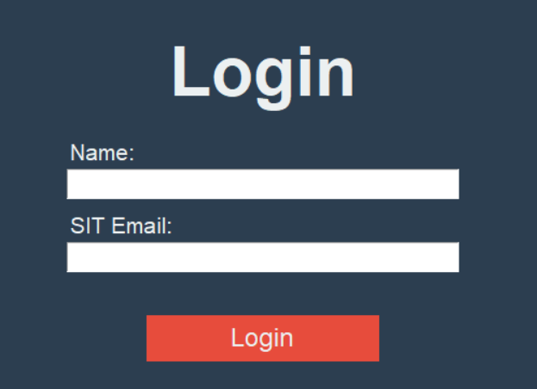
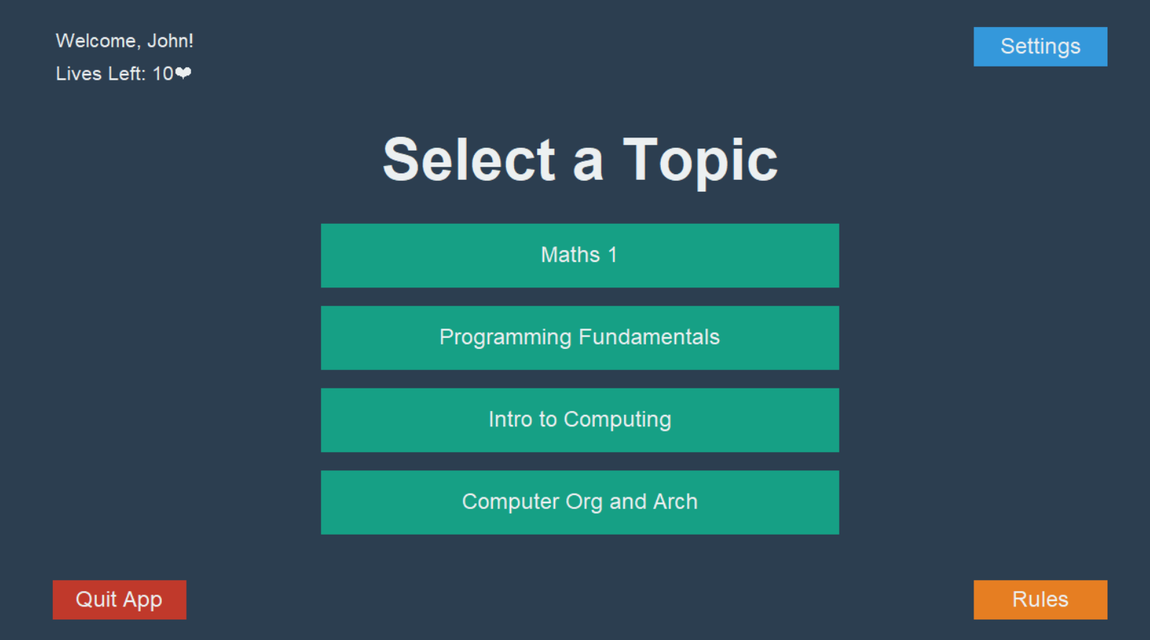
User Interface
Notes:
In the first image, you can see the login screen. This screen is built using several key UI elements:
Text labels are used to display static text like 'Name' and 'SIT Email' to help guide the user.
Text boxes allow the user to input their Name and email.
There’s a Login button that, when clicked, triggers the login process and validates the user’s input.
Once the user has logged in, they are directed to the Select Topic page, which is shown in the second image.
Here, we’ve used a variety of elements:
A text label displays a welcome message, personalized for the user. It uses the name input which the user entered during the login process.
Another text label shows the number of lives the user has left.
Several buttons allow the user to navigate. There are options to access settings, quit the game, view the rules, and most importantly, buttons to select the topic they want to play. Each button is linked to a specific command that directs the user to the appropriate frame, such as the game or settings page.
These UI components work together to create a clean interface, helping the user smoothly transition from logging in to selecting their game topic. The use of dynamic text updates, clear labels and distinct colors for the buttons ensures a user-friendly experience.

Slide 10
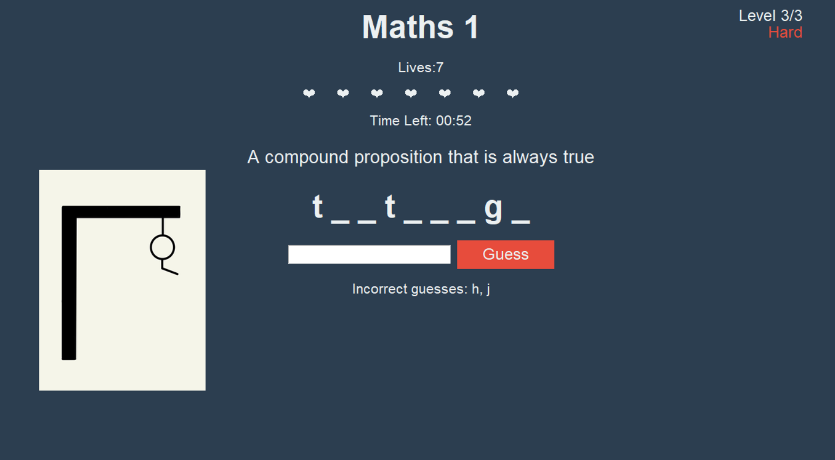
User Interface
Notes:
This screen contains several key UI elements that guide the user through the game and provide feedback.
At the top right, there is the difficulty level as well as the stage of the game they are at. In this case hard and level 3 out of 3.
Beside it, the title label shows the topic, in this case, 'Maths 1,' giving the user context topic they have selected, in case they forget or are confused
Below that we have a label to display the amount of lives the user has left.
Below that, we have the hearts which represent the player’s remaining lives.
Following that, there timer shows how much time is left, adding pressure in hard difficulty mode. This will be expanded on later in the presentation.
Below the timer is the question the user has to answer. In this case, the question is 'A compound proposition that is always true.'
The blank lines indicate the number of letters in the word the player needs to guess. As they guess correct letters, those blanks will be filled in.
To the left, we have the Hangman image, which corresponds to the amount of lives the user has left.
The input text box allows the player to type in their guesses, and the Guess button submits the player’s input.
Finally, below the input box, there's a list of incorrect guesses, showing the letters the player has guessed incorrectly. This helps them avoid repeating the same mistakes.

Slide 11
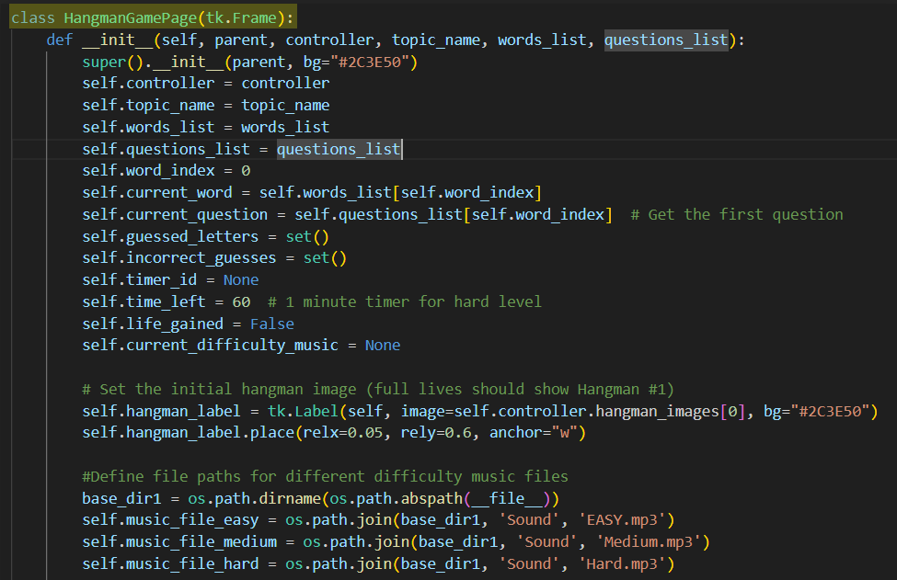
User Interface Code
Notes:
Now, let’s take a closer look at the code structure behind this interface. Here, you can see the class HangmanGamePage. This is one of the many frames in the application, and as you can see from the code, each frame has its own distinct variables and functions. This structure allows each frame to manage its own behavior, this approach improves readability, making the code easier to maintain and to build upon.

Slide 12
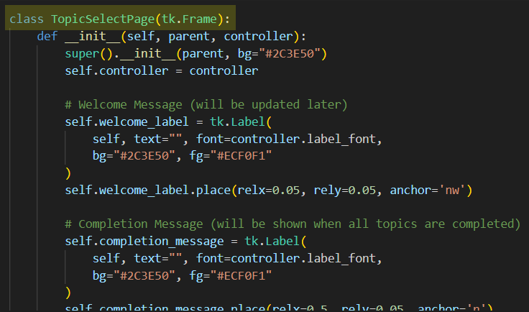
User Interface Code
Notes:
Expanding on that, Slide 13 shows another class, TopicSelectPage. Like the Hangman game page, this page has its own set of variables and functions, handling everything from loading the topics to updating the user’s view.

Slide 13
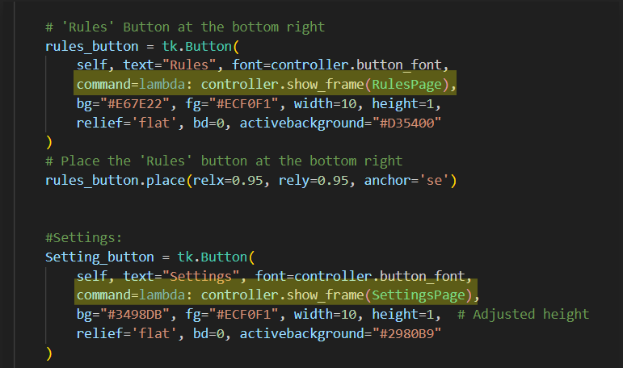
User Interface Code
Notes:
Finally, on Slide 14, we have a picture showing how the buttons are programmed with commands. Each button brings the user to the desired frame in the application. This means that when a user clicks a button, such as 'Rules' or 'Settings', they are directed to the corresponding frame, making the user experience smooth and intuitive.

Slide 14
03
Settings Page

Slide 15
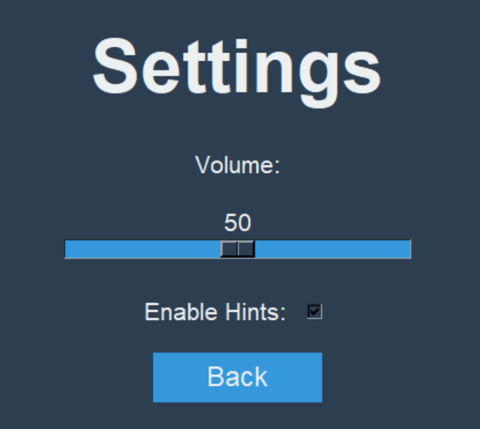
Settings UI
In our settings page, we have the two main functions
Adjusting of the music volume
Allowing user to enable hints
User to go back to mainpage

Slide 16
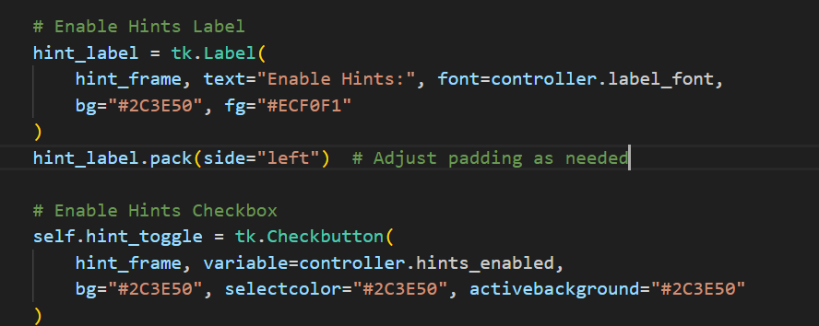
Source code for hint UI
Notes:
For the first part of the code “hint_label” basically is allowing the label to be shown in the settings UI what that checkbox is for in this case is whether the user choose to enable hints when doing the hangman game.The hint_toggle is so that the user can toggle on and off the checkbox

Slide 17
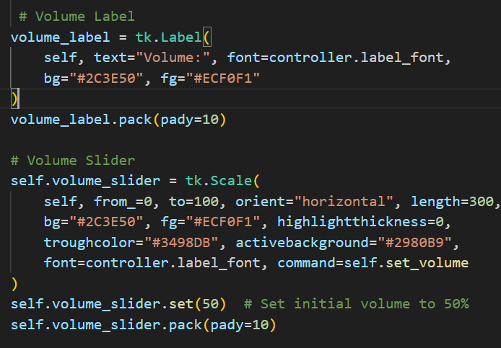
Source code for Volume UI
Notes:
This line initializes a new scale widget (a slider) and assigns it to the volume_slider attribute of the current class instance (self) and the parameter that we set the range for the slider is from 0 to 100 which is the typical for volume controls.
Orient basically means orientation of the slider in this case we put it to horizontal and the length indicate how many pixels it is in the settings game. And when the game run up the default volume we set is 50.

Slide 18
04
Game Logic (Hint)

Slide 19
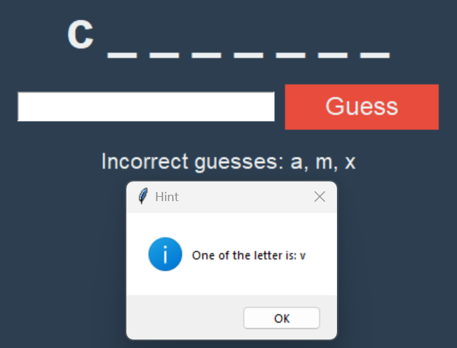
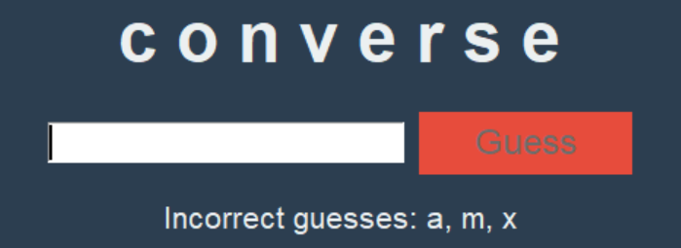
Hint feature
In this test scenario, the user input 1 correct guess and 3 incorrect guesses
The hint message box pop up would be shown for the answer.

Slide 20
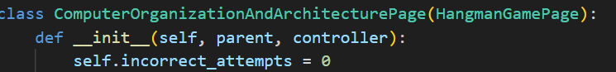
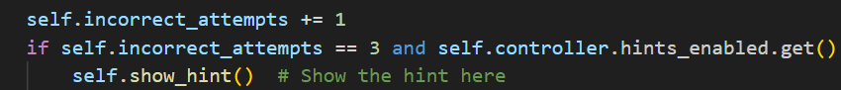
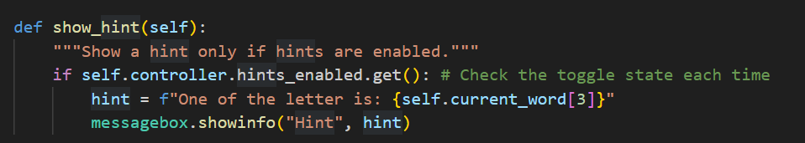
Source code for hint
Notes:
Self.incorrect_attempts is initialized to 0 in this case for our computerArch Page but it is done to all of our different module that we have and when the user input an incorrect attempt the variable will have a increment of 1 and when the attempts reaches 3 the if statement as shown would run and this the hint would be shown as explained by the previous slides
Self.controller.hints.enabled.get is to check whether the user enabled the hints at the settings page if they have. Then this lines of code would run when they have 3 incorrect guesses. In the test scenario the correct answer was converse hence the message box indicated the fourth letter of the answer.

Slide 21
05
Game Logic (Difficulty)

Slide 22
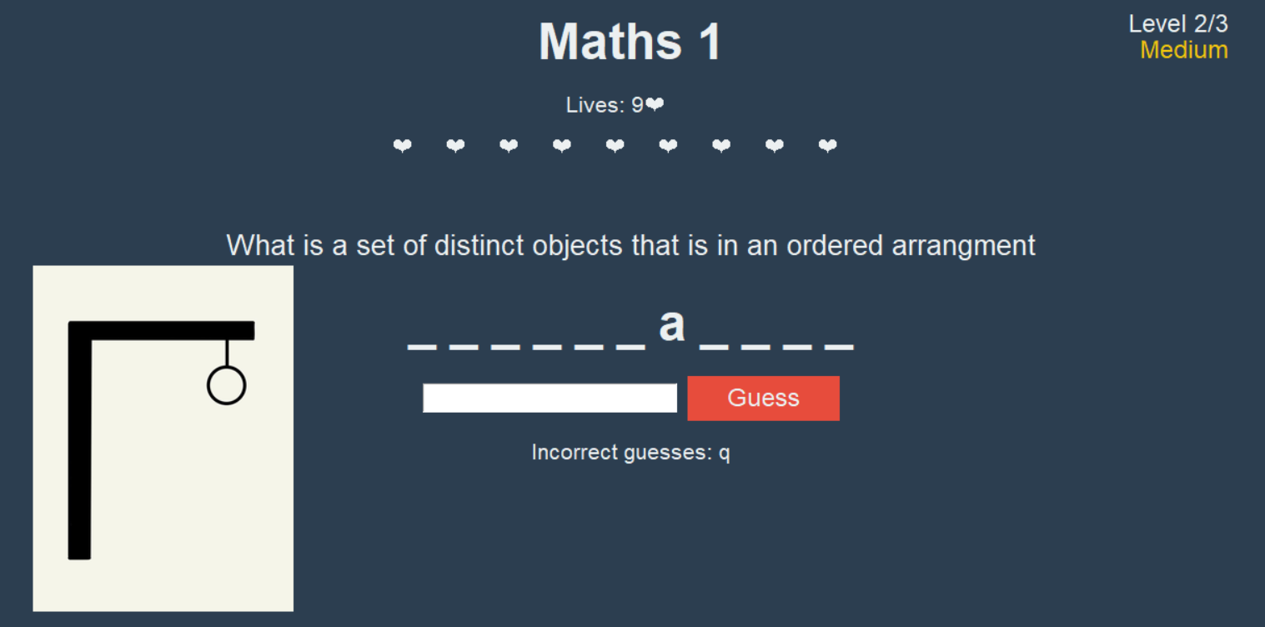
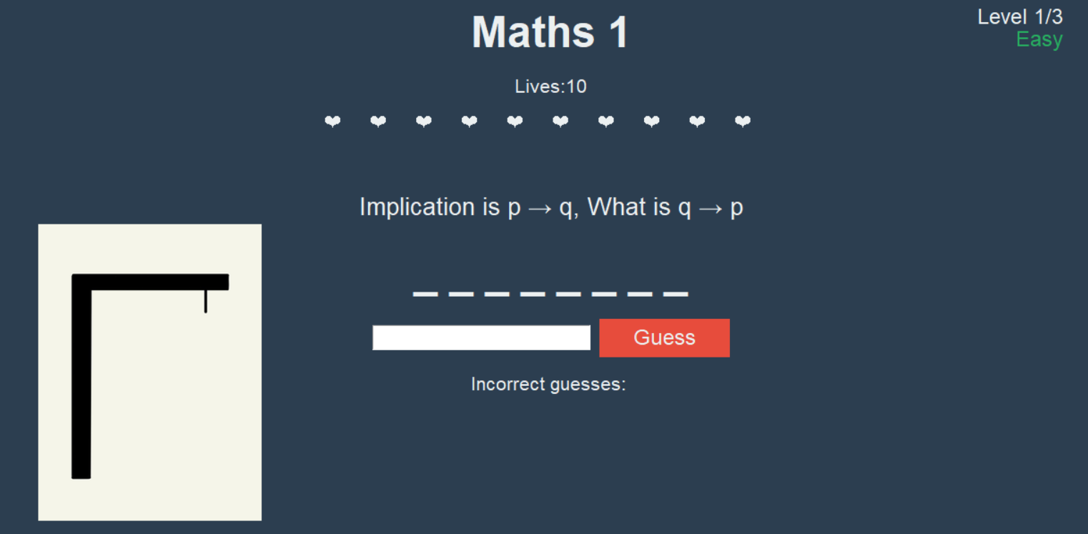
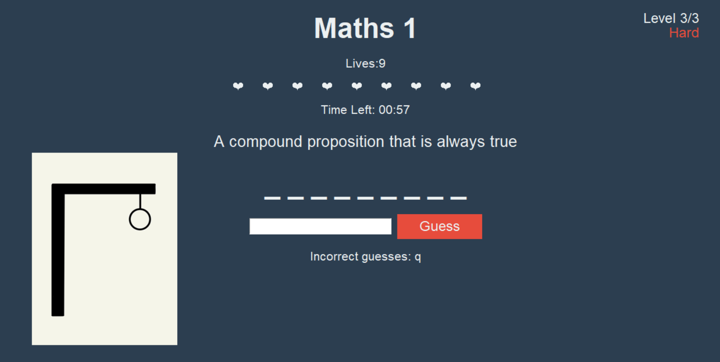
Overview on difficulty
Difficulty Levels: Easy/Medium/Hard
Easy & Medium:
Hard (Contains a timer of 60 seconds):

Slide 23
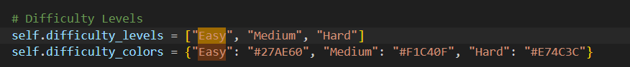
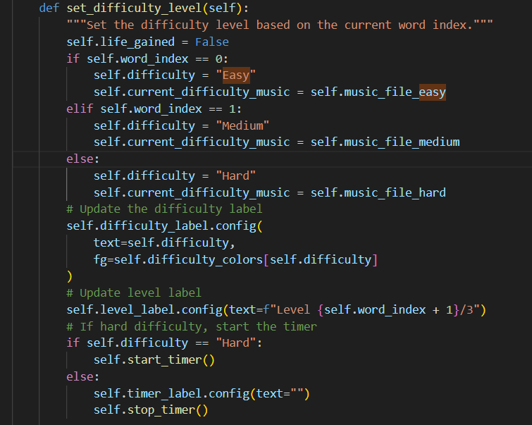
Source code for difficulty

Slide 24
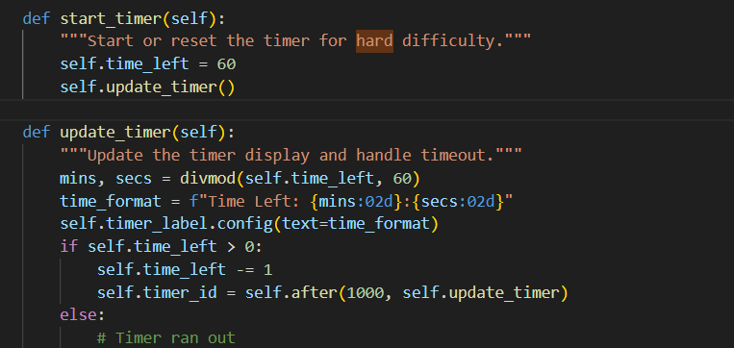
Source code for difficulty

Slide 25
06
Game Logic (Health & Regen)

Slide 26

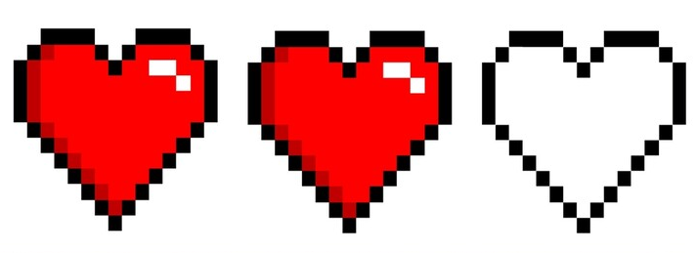
Overview on health & Regen
User start off with a total of 10 lives
For every wrongly guess letter, 1 lives will be minus off
To gain the 1 live:
Easy → 3 correct letters
Medium & Hard → 4 correct letters
If lives are gone, user will need to restart the whole game (go back to login screen)

Slide 27
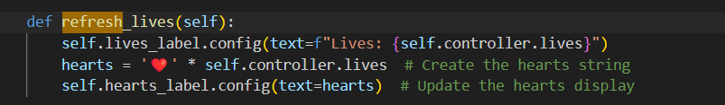

Source code for health
Notes:
Codes for lives heart shape

Slide 28
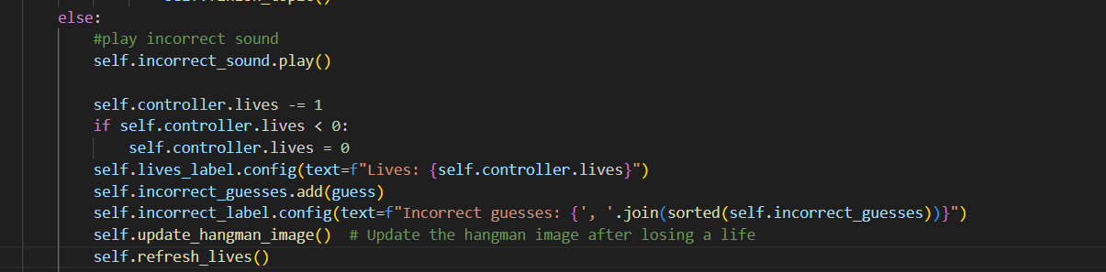
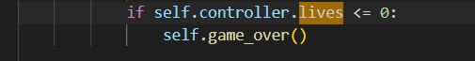
Source code for health (No timer)
Notes:
Initialise live to 10, if got wrong minus lives
Apply for easy and medium

Slide 29
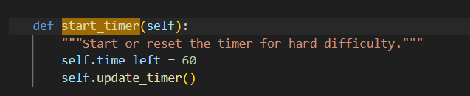
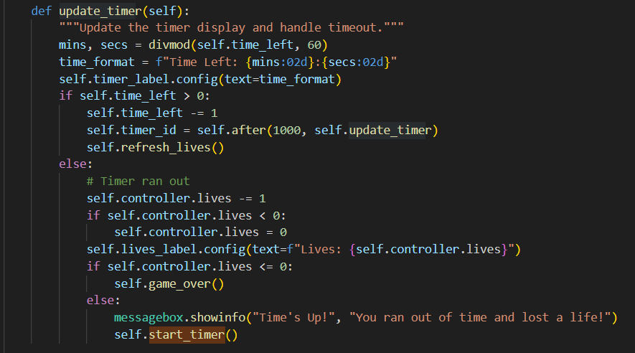
Source code for health (With Timer)
Notes:
If timer run out minus life
Apply for hard

Slide 30
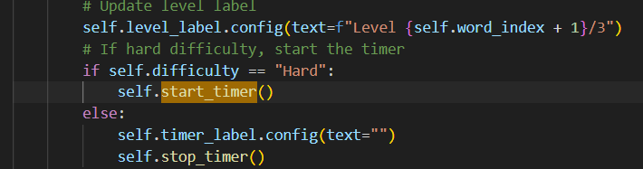
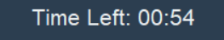
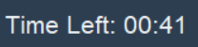
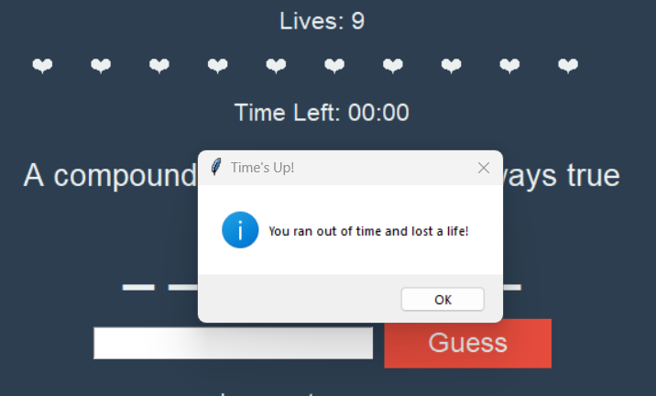
Source code for health (With Timer)
Notes:
If timer run out minus life
Apply for hard

Slide 31
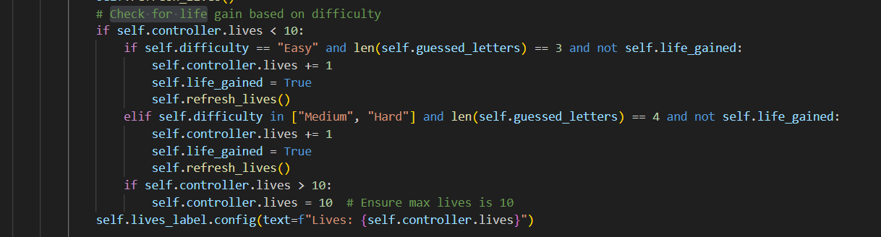
Source code for Lives gain (Regen)
Notes:
This is a screenshot of the lives gain code, the logic behind it is that
First it will check if the number of lives left is less than 10, why 10? As we do not want the user to gain extra lives which make it 11. Hence the logic will be ruin.
Then it will check the difficulty of the lifes, based on the overview I mentioned earlier, for easy, user need to guess 3 correct letters to gain a live back.
So why is there self.live_gained?
→ It is because the firstly in the code above (line 567 - self.life_gained = False) we set it to false, when in the if statement of the screenshot, it shows if true then the user deserve to gain the lives. This logic is that to prevent the user to keep gaining lives after 3 correct attempts.
Since we have that logic for easy, we can just duplicate for medium and hard level where to gain lives user need to get 4 correct letters.
What if somehow, the user manage to get more than 10 lifes, there's where line 806 comes into play, this conditions always ensure that lives cannot be more than 10.
After we have the logic structured, we just print out the output which is “self.lives_label.config(text=f"Lives: {self.controller.lives}❤️")
“
For every level / next word and even when the user restart the game, we ensure that to reset the lives gain back to false.

Slide 32
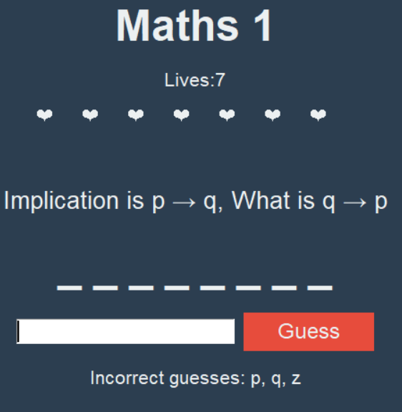
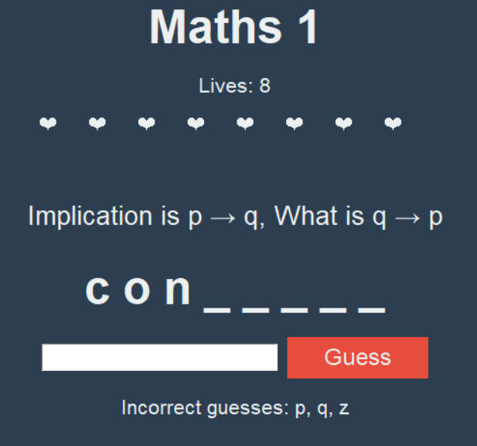
Source code for Lives gain (Regen)

Slide 33
07
Game Logic (Validation)

Slide 34
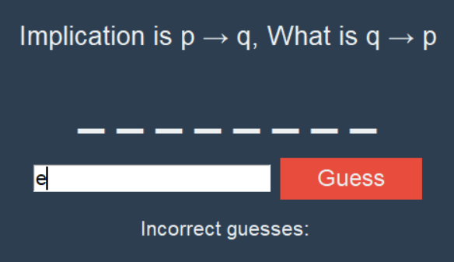
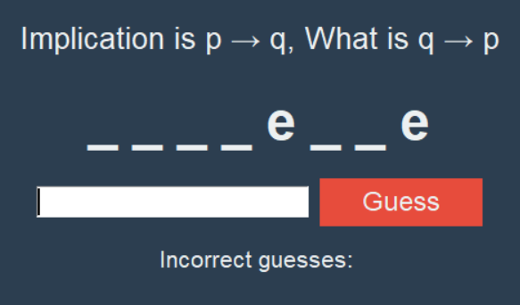
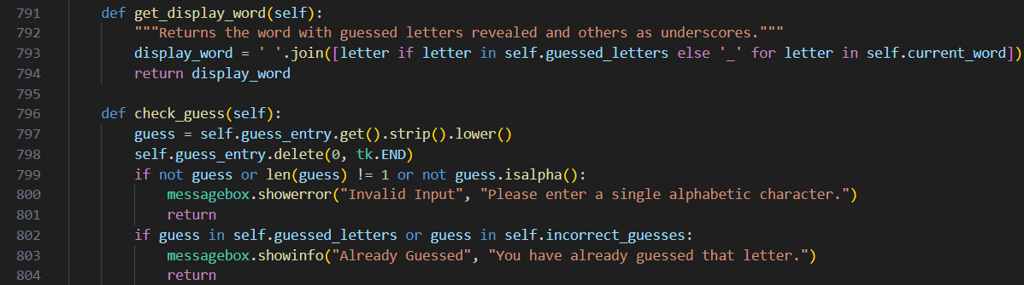
Input Validation
Valid input
When the user inputs an alphabet that is in the answer

Slide 35
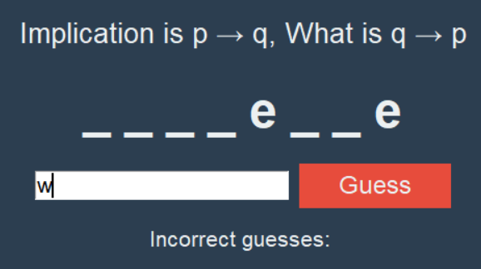
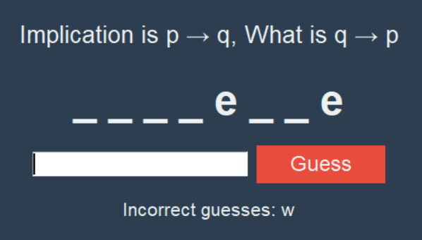
Input Validation
Valid input
When the user inputs an alphabet that is NOT in the answer

Slide 36
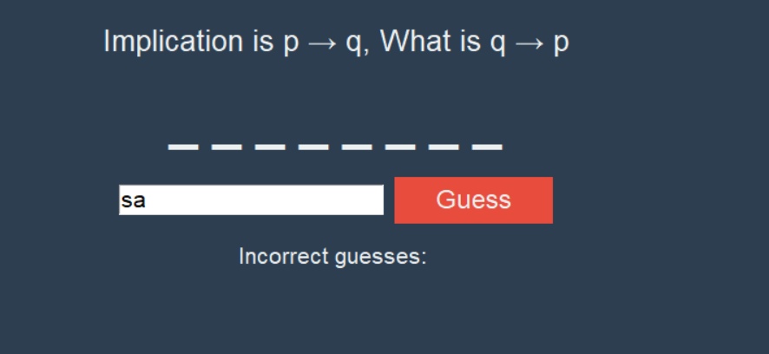
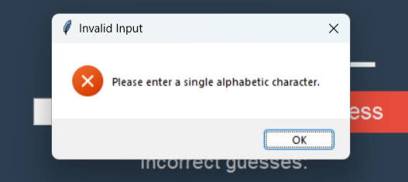
Input Validation
Invalid Input
When the user inputs more than one input

Slide 37
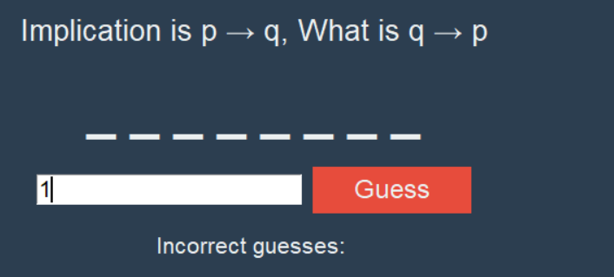
Input Validation
Invalid Input
When the user inputs an integer

Slide 38
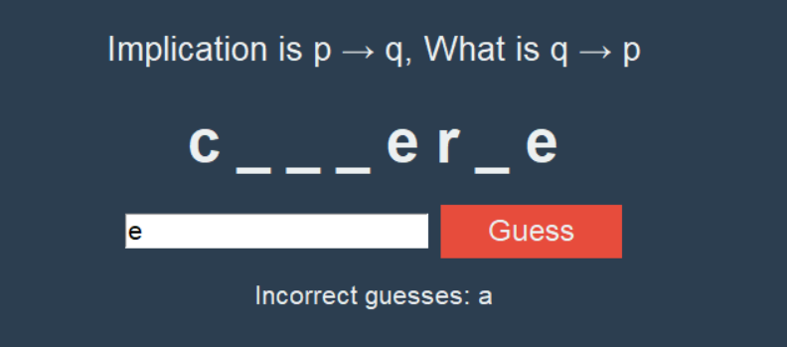
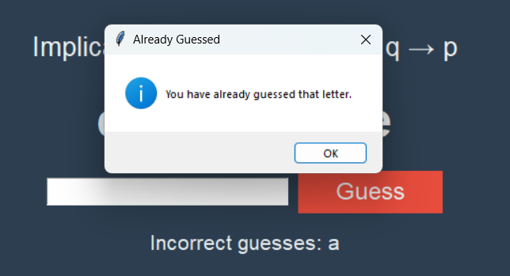
Input Validation
Invalid input
When the user inputs a word that has already been input before

Slide 39
08
Game Logic (Images)

Slide 40
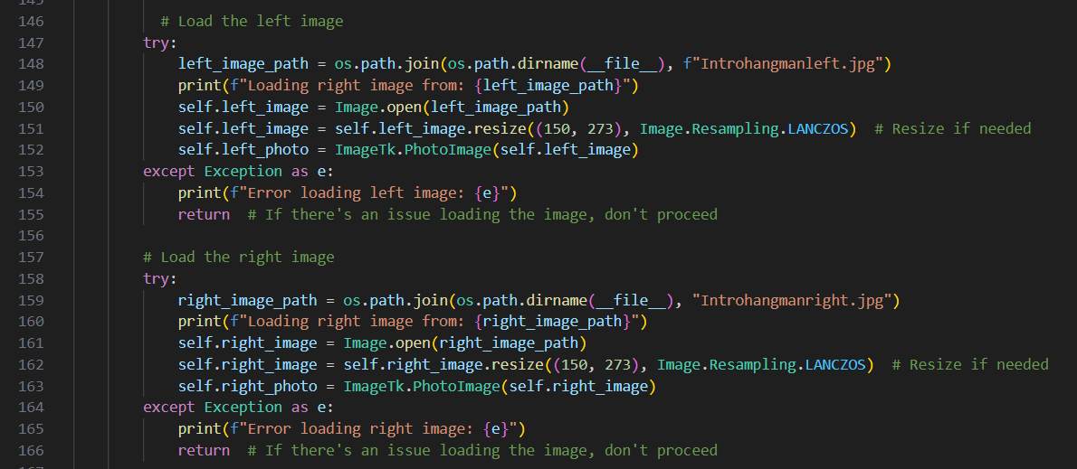
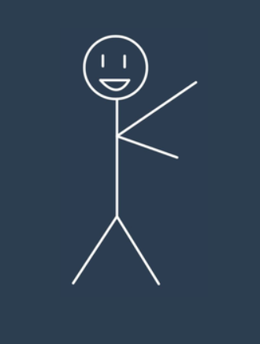
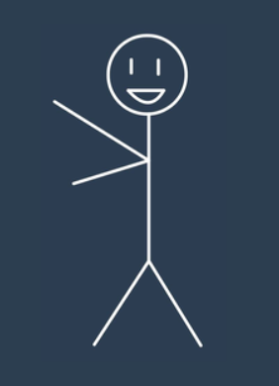
Loading of Images (Login hangman)
introhangmanleft.jpg
introhangmanright.jpg

Slide 41



Arranging the Images in the application (Login hangman)

Slide 42











Hangman Life stages
10 Lives
9 Lives
8 Lives
7 Lives
6 Lives
Hangman #1
Hangman #2
Hangman #3
Hangman #4
Hangman #5
5 Lives
4 Lives
3 Lives
2 Lives
1 Life
Hangman #6
Hangman #7
Hangman #8
Hangman #9
Hangman #10

Slide 43

Loading of Images (Hangman stages)
Store the 10 images as list

Slide 44


Function to update image
Calling the function

Slide 45

Hangman image is always in line with number of lives left

Slide 46
09
Music

Slide 47

Music Implementation
Use music for
Background Music @ Start page
Correct/Incorrect Answer
Easy Level
Medium Level
Hard Level
Notes:
“In this part of our Hangman game, we implemented background music and sound effects to enhance the user experience. The game uses different soundtracks based on the selected difficulty level: Easy, Medium, or Hard. Each track is designed to match the mood and intensity of the level, adding to the immersive experience for players. We also incorporated sound effects for wrong guesses, adding immediate audio feedback for user actions.”

Slide 48

Overview
Overview: The Hangman game incorporates background music that changes depending on the selected difficulty level (Easy, Medium, or Hard). This music enhances the gaming experience by providing an immersive atmosphere.
How the Music Works: Loading Music: The game uses the pygame library to load and play music. The paths for the music files are set up when the game starts. Playing Music: Once the difficulty level is chosen, the corresponding music file is loaded and played in a continuous loop. This is done using pygame.mixer.music.play(). Stopping Music: If the player switches levels or restarts the game, any currently playing music is stopped before the new track starts. Volume Control: Players can adjust the music volume using an in-game slider. This is dynamically applied using pygame.mixer.music.set_volume().
Notes:
“Our game uses the pygame library to manage and play background music and sound effects. Here’s how the system works:
Loading Music: When the game starts, the appropriate music file is loaded based on the difficulty level.
Playing Music: The music is set to loop throughout the gameplay using pygame.mixer.music.play(-1), ensuring continuous background music.
Stopping Music: When the player switches levels or restarts the game, the current track stops, and the new track for the selected difficulty begins.

Slide 49


Code for Music Implementation
Importing pygame module
Loading music files for different difficulty level
To handle the audio in the game, the pygame library is used. This module includes functionality for loading and playing sound files.
Different music files are loaded based on the difficulty level selected in the game. The paths for the music files are set as follows:
Notes:
Import: “To handle music and sound effects, we used the pygame library, which provides a powerful API for loading and playing audio files Loading: Explanation: The code defines the paths to the music files for each difficulty level. These files are then loaded based on the player's selected difficulty level to ensure the appropriate background music plays. In the code, we store the file paths for each difficulty level’s background music. When the player selects Easy mode, for example, the game loads the EASY.mp3 file using pygame.mixer.music.load(). This prepares the music for playback when the game starts. Each difficulty level is associated with its own specific music track.

Slide 50



Code for Music Implementation
Playing music base on difficulty
When the game starts, the music corresponding to the selected difficulty level is played. Here’s how the music is played using pygame.mixer.music The pygame.mixer.music.load() function loads the appropriate music file based on the difficulty level.
The pygame.mixer.music.play(-1) ensures that the music loops continuously during the game.
Adjusting of the volume
The game allows for volume adjustment through a slider, and the volume is set by converting the slider value (from 0 to 100) into a range from 0.0 to 1.0:
Notes:
Bse on Diff The code ensures that only the appropriate track for the selected difficulty level is played. If the player switches difficulty, the previous track stops and the new one starts seamlessly using the pygame.mixer.music.load() Adjust: The slider in the settings page controls the volume. We convert the slider’s value from a scale of 0 to 100 into a decimal range (0.0 to 1.0), which Pygame uses for volume control. The user can easily increase or decrease the volume using this slider.

Slide 51



Code for Music Implementation
Playing music when correct/incorrect answer
Notes:
Explanation: Whenever the player makes an incorrect guess, the game triggers an error sound using pygame.mixer.Sound(). Similarly, correct guesses could trigger a success sound, creating a more responsive and engaging experience for players.

Slide 52
10
Completion

Slide 53


Completion Page
Player s
Completion Message: When the player successfully completes all the topics, a message congratulates them, and rewards like a voucher may be offered (in this case, just part of the code).
Completion Music: Once the game is completed, special music plays to signify the player's success.
Game Over Logic: If the player loses, the game shows a "Game Over" message and plays the completion music, encouraging them to try again.
Notes:
“When the player completes the game, a completion page is displayed with a congratulatory message. This page also includes special completion music that is triggered to celebrate the player's achievement.”

Slide 54


Code for Completion Page
Completion Message Display
Completion Music
When all the topics in the game are completed, the system will display a message saying "Congrats for completing this quiz, you have won a $20 voucher...". This is likely the final message shown to the player upon successful completion of the game.
This function plays completion music when the game is finished. It loads the music file and starts playing it to enhance the feeling of victory.
Notes:
The game checks whether the player has completed all the topics. If they have, the completion message is displayed, and a celebratory track is played using play_completion_music(). This function loads the music file completion_music.mp3 and plays it to mark the successful end of the game.

Slide 55

Code for Completion Page
Game Over
If the player loses the game (i.e., they run out of lives), a message box pops up with a "Game Over" notification.
Notes:
Explanation: When the player loses the game by running out of lives, the game displays a message box showing "Game Over" and plays a specific track for the game over scenario. This helps to clearly signal that the game has ended and prompts the player to restart or try again.

Slide 56
Conclusion
Learning Point 1
Learning Point 2
Learning Point 3
Sound and Music Integration: We successfully learned how to implement background music and sound effects using the pygame library, which enriched the game experience.
GUI Development with Tkinter: We gained hands-on experience in building a graphical user interface (GUI) using Tkinter, making the game more interactive and visually engaging.
Managing Game State: We learned how to manage different game states such as tracking player progress, handling win/loss conditions, and displaying completion messages.
Improvement
Leaderboard and Online Integration: Implement an online leaderboard where players can compare their scores globally. Adding online features, such as user profiles and global rankings, could make the game more competitive and engaging.

Slide 57
Thank You!

